Slide 1

Developing a Cross-Campus Approach to Addressing Basic Needs Insecurities
at Mt. San Antonio College
Dr. Eric Lara, Associate Dean, Student Equity and Success Dr. Koji Uesugi, Dean, Student Services
Pauline Swartz, Professor, Reference/Instruction Librarian

Slide 2
Today’s Goals
Understand the Problem: Basic Needs Insecurities
Findings from recent studies | Impact on student success
Share Ways We Are Addressing the Problem
CalFresh | Mountie Fresh Day |Monthly Food Pantry | Food Vouchers | Gas Cards | Housing Referrals
Generate Ideas to Address the Problem & Collaborate
Brainstorming and Discussion

Slide 3

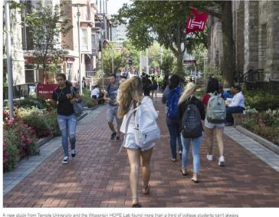
the two-way BREAKINGNEWSFROMNPR
fl
AMERICA
Hunger And Homelessness Are
Widesp read Among College Students, Study Finds
Apr 3. 2018 8 48 PH ET
VANESSA ROMO

Slide 4
Definitions
Food Insecurity
"Is the or
limited
uncertain availability
of y
, or the ability to acquire such foods in
nutritionall
adequate and safe foods
a socially acceptable manner.”
Housing Insecurity
"A
broad set of challenges
such as the
inability to pay rent or utilitie
s or
the
need to move frequently
.”
Homelessness
"Means that a person is
a an
without a place to live,
often residing in or .”
shelter,
automobile,
an a
bandoned building
outside
From Wisconsin HOPE Lab’s “Still Hungry and Homeless in College”

Slide 5
Food & Housing Survey Results
Food Insecure
Housing Insecure
Homeless
National HOPE Lab
(43,000 responses. Table reflec ts approx.
23,000 c ommunity c ollege students.)
42%
46%
12%
LACCD HOPE Lab
(5,925 responses)
68%
55%
19%
Mt. SAC
(552 responses)
30% * 18%
*Housing insecurity was not asked of students for the Mt. SAC survey.

Slide 6
6% Thrown out of their homes
21% Felt unsafe where I was living
33% Had difficulty paying the rent/mortgage
40% A conflict or problem with someone I lived with
58% I was in another difficult situation
Common Causes of Homelessness (HOPE Lab, 2018)

Slide 7

Basic needs insecurities
have been found to...
“...lead to greater levels of stress, anxiety, unhealthy eating patterns, and a greater risk of chronic illness”
“inhibit students’ sense of belonging, leading to more unwelcoming experiences with faculty”
Increase students’ “intention to drop out of
college”
“impede their confidence in their abilities [and] their perceptions of the importance of their academic pursuits”
Be correlated with lower grades in college
Still Hungry and Homeless in College (2018), Five Critical Facts about Men of Color and Food Insecurity in Community Colleges (2016),
Struggling to Survive, Striving to Succeed (2016)

Slide 8
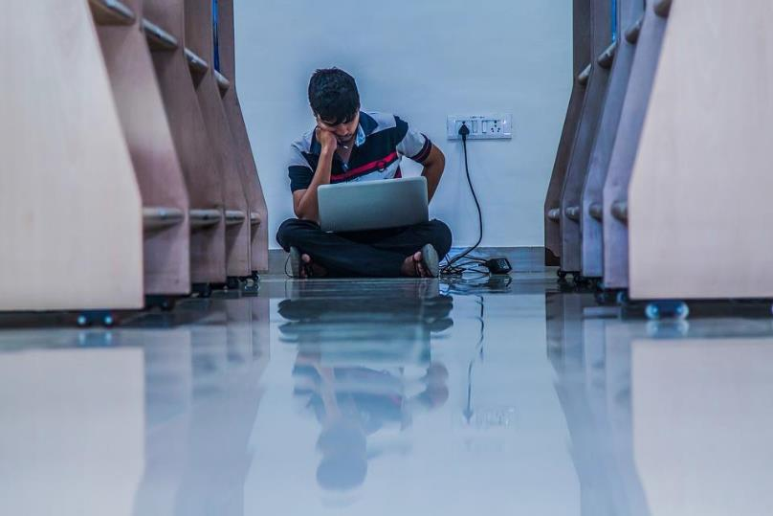
Worked more often & later shifts
Spent more time taking care of children and other family members
Spent more time commuting
Spent less time sleeping & on leisure activities
Spent similar time as other students attending class and doing homework
Students Experiencing Basic Needs Challenges & Commitment to School, HOPE Lab, 2018

Slide 9

How can you recognize when students are experiencing basic needs insecurities?
How do you
assist them?

Slide 10
Mt. SAC’s Response
Student Equity funds various projects on campus that addresses basic needs insecurities
Homelessness & Basic Resources Committee was launched in fall 2017

Slide 11



Current Resources

Slide 12
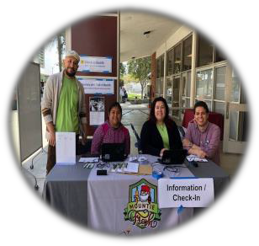
CalFresh &
Monthly Food Pantry
CalFresh is a federally funded nutrition assistance program providing students with funds for fresh food!
Electronic Benefits Transfer (EBT) cards to access CalFresh funds are accepted at groceries stores, many farmers markets, Trader Joe’s, etc.
The Mountie Fresh Food Pantry takes place once a month at the Student Life Center Patio (9C).

Slide 13
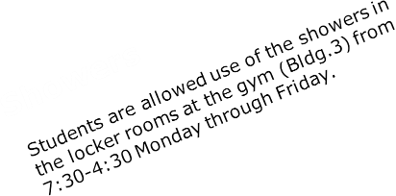

More Resources

Slide 14
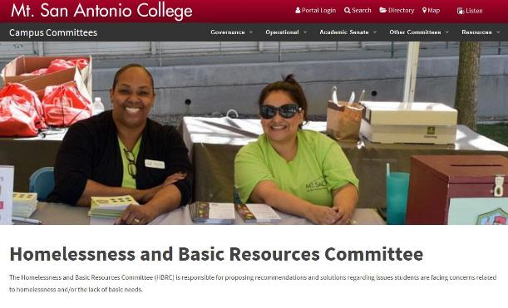
http://www.mtsac.edu/governance/committees/hbrc/

Slide 15

Fighting the Stigma

Slide 16

Less Silos and More Collaboration

Slide 17
We Need Your Ideas!
Do this first: In groups, brainstorm resources that can help
students with challenges related to food & housing insecurities.
Do this second: Pick your top 5-6 ideas. Then think about how students would access those resources. A hub?
Think about this: (adding more is ok )
What could students get there?
(Goods? Services? Information? Something else?)
How would students feel when they’re there?
How could people from all over campus be involved?
What support would be needed to make it successful?
Don’t forget to do this:
Write your ideas! We need your help & expertise. Thanks!

Slide 18





What can we do?
as individual faculty?
with our departments?
throughout campus?

Slide 19
Thank You!
Got follow up questions/ideas? Contact us!
Dr. Eric Lara, Associate Dean, Student Equity and Success Dr. Koji Uesugi, Dean, Student Services
Pauline Swartz, Professor, Reference/Instruction Librarian

